Slide 1
RL Theory

Slide 2
Uniform distributed, independent generalization error, q-learning
Good convergence
Lucky convergene
Bad convergence
Divergence

Slide 3
some progress
Summarize the existence algorithms.
Analysis the convergence proof.
Try to generalization the convergence proof to algorithms with nonlinear function approximation and off policy control.

Slide 4
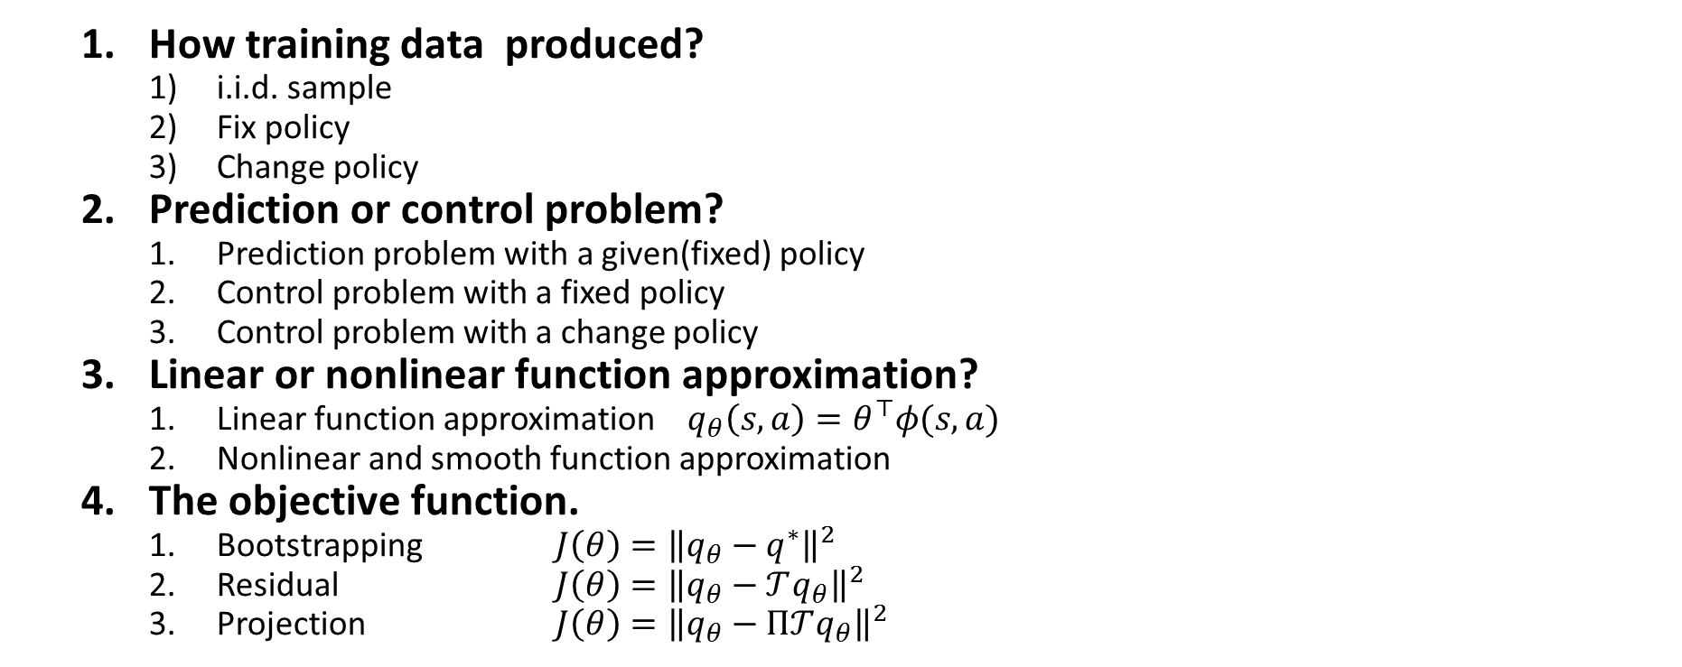
Overview: the key aspect of algorithms
How training data produced?
i.i.d. sample
Fix policy
Change policy
Prediction or control problem?
Prediction problem with a given(fixed) policy
Control problem with a fixed policy
Control problem with a change policy
Linear or nonlinear function approximation?
Linear function approximation $q_{θ}\left(s,a\right)=θ^{⊤}φ(s,a)$
Nonlinear and smooth function approximation
The objective function.
Bootstrapping $J\left(θ\right)={\left\|q_{θ}−q^{∗}\right\|}^{2}$
Residual $J\left(θ\right)={\left\|q_{θ}−𝒯q_{θ}\right\|}^{2}$
Projection $J\left(θ\right)={\left\|q_{θ}−Π𝒯q_{θ}\right\|}^{2}$

Slide 5
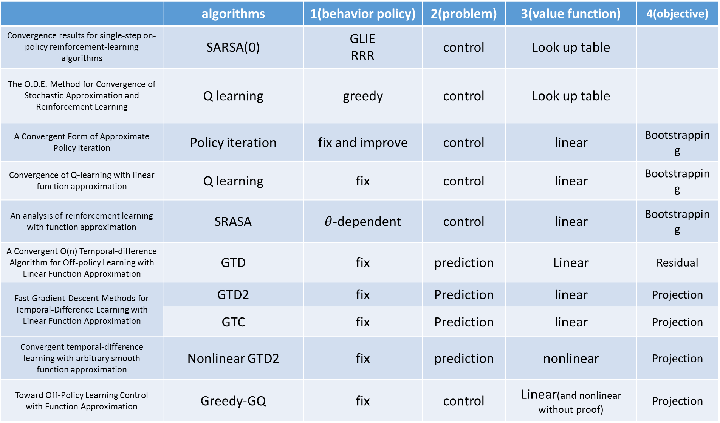
 | algorithms | 1(behavior policy) | 2(problem) | 3(value function) | 4(objective)
Convergence results for single-step on-policy reinforcement-learning algorithms | SARSA(0) | GLIE RRR | control | Look up table
The O.D.E. Method for Convergence of Stochastic Approximation and Reinforcement Learning | Q learning | greedy | control | Look up table
A Convergent Form of Approximate Policy Iteration | Policy iteration | fix and improve | control | linear | Bootstrapping
Convergence of Q-learning with linear function approximation | Q learning | fix | control | linear | Bootstrapping
An analysis of reinforcement learning with function approximation | SRASA | $θ$-dependent | control | linear | Bootstrapping
A Convergent O(n) Temporal-difference Algorithm for Off-policy Learning with Linear Function Approximation | GTD | fix | prediction | Linear | Residual
Fast Gradient-Descent Methods for Temporal-Difference Learning with Linear Function Approximation | GTD2 | fix | Prediction | linear | Projection
 | GTC | fix | Prediction | linear | Projection
Convergent temporal-difference learning with arbitrary smooth function approximation | Nonlinear GTD2 | fix | prediction | nonlinear | Projection
Toward Off-Policy Learning Control with Function Approximation | Greedy-GQ | fix | control | Linear(and nonlinear without proof) | Projection

Slide 6
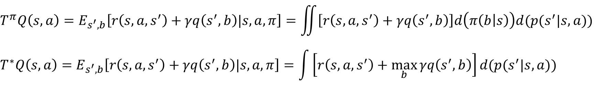
Update rule
Policy iteration with look up table
Value iteration with look up table
Td(0) with look up table
SARSA with look up table
Q-learning with look up table
Td(0) with linear function approximation
Q-learning with linear function approximation
SARSA with linear function approximation
$$T^{π}Q\left(s,a\right)=E_{s^{′},b}\left[r\left(s,a,s^{′}\right)+γq\left(s^{′},b\right)|s,a,π\right]=\iint{\left[r\left(s,a,s^{′}\right)+γq\left(s^{′},b\right)\right]d\left(π\left(b | s\right)\right)d(p(s^{′}|s,a))}$$
$$T^{∗}Q\left(s,a\right)=E_{s^{′},b}\left[r\left(s,a,s^{′}\right)+γq\left(s^{′},b\right)|s,a,π\right]=\int{\left[r\left(s,a,s^{′}\right)+\max_{b}{γq\left(s^{′},b\right)}\right]d(p(s^{′}|s,a))}$$

Slide 7
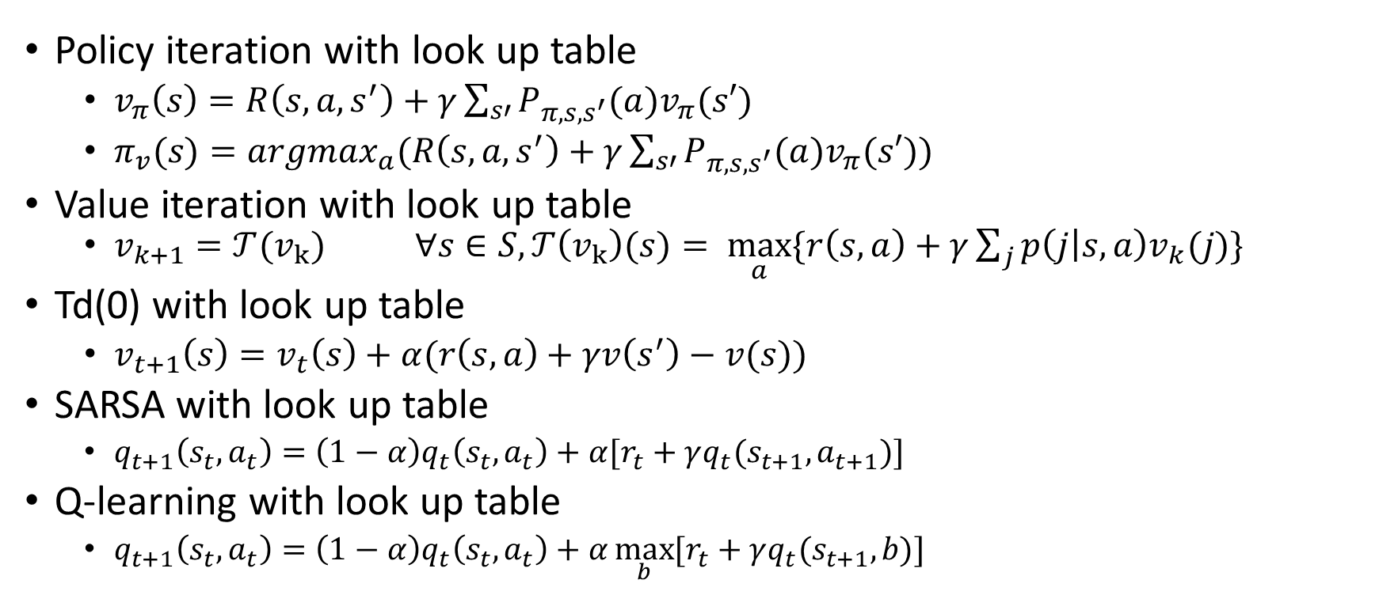
Update rule
Policy iteration with look up table
$v_{π}\left(s\right)=R\left(s,a,s^{′}\right)+γ\sum_{s′}{P_{π,s,s^{′}}(a)v_{π}(s′)}$
$π_{v}(s)=argmax_{a}(R\left(s,a,s^{′}\right)+γ\sum_{s′}{P_{π,s,s^{′}}(a)v_{π}(s′)})$
Value iteration with look up table
$v_{k+1}=𝒯(v_{k})$ $∀s∈S,𝒯\left(v_{k}\right)(s)= \max_{a}{\{r\left(s,a\right)+γ\sum_{j}{p\left(j | s,a\right)v_{k}(j)}\}}$
Td(0) with look up table
$v_{t+1}\left(s\right)=v_{t}\left(s\right)+α(r\left(s,a\right)+γv\left(s^{′}\right)−v(s))$
SARSA with look up table
$q_{t+1}\left(s_{t},a_{t}\right)=\left(1−α\right)q_{t}\left(s_{t},a_{t}\right)+α[r_{t}+γq_{t}(s_{t+1},a_{t+1})]$
Q-learning with look up table
$q_{t+1}\left(s_{t},a_{t}\right)=\left(1−α\right)q_{t}\left(s_{t},a_{t}\right)+α\max_{b}{[r_{t}+γq_{t}(s_{t+1},b)]}$

Slide 8
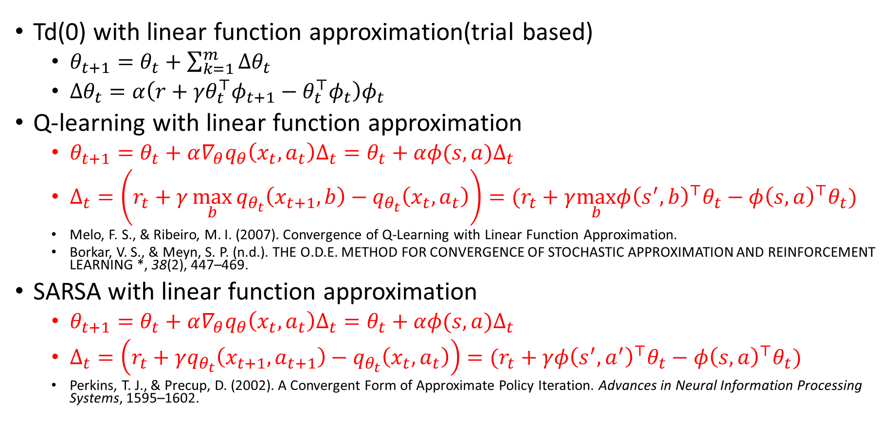
Update rule
Td(0) with linear function approximation(trial based)
$θ_{t+1}=θ_{t}+\sum_{k=1}^{m}{Δθ_{t}}$
$Δθ_{t}=α\left({{r+γθ}_{t}^{⊤}φ}_{t+1}−{θ_{t}^{⊤}φ}_{t}\right)φ_{t}$
Q-learning with linear function approximation
$θ_{t+1}=θ_{t}+α∇_{θ}q_{θ}\left(x_{t},a_{t}\right)Δ_{t}=θ_{t}+αφ(s,a)Δ_{t}$
$Δ_{t}=\left(r_{t}+γ\max_{b}{q_{θ_{t}}\left(x_{t+1},b\right)}−q_{θ_{t}}\left(x_{t},a_{t}\right)\right)=(r_{t}+γ\max_{b}φ{\left(s^{′},b\right)}^{⊤}θ_{t}−φ{\left(s,a\right)}^{⊤}θ_{t})$
Melo, F. S., & Ribeiro, M. I. (2007). Convergence of Q-Learning with Linear Function Approximation.
Borkar, V. S., & Meyn, S. P. (n.d.). THE O.D.E. METHOD FOR CONVERGENCE OF STOCHASTIC APPROXIMATION AND REINFORCEMENT LEARNING *, 38(2), 447–469.
SARSA with linear function approximation
$θ_{t+1}=θ_{t}+α∇_{θ}q_{θ}\left(x_{t},a_{t}\right)Δ_{t}=θ_{t}+αφ(s,a)Δ_{t}$
$Δ_{t}=\left(r_{t}+γq_{θ_{t}}\left(x_{t+1},a_{t+1}\right)−q_{θ_{t}}\left(x_{t},a_{t}\right)\right)=(r_{t}+γφ{\left(s^{′},a^{′}\right)}^{⊤}θ_{t}−φ{\left(s,a\right)}^{⊤}θ_{t})$
Perkins, T. J., & Precup, D. (2002). A Convergent Form of Approximate Policy Iteration. Advances in Neural Information Processing Systems, 1595–1602.

Slide 9
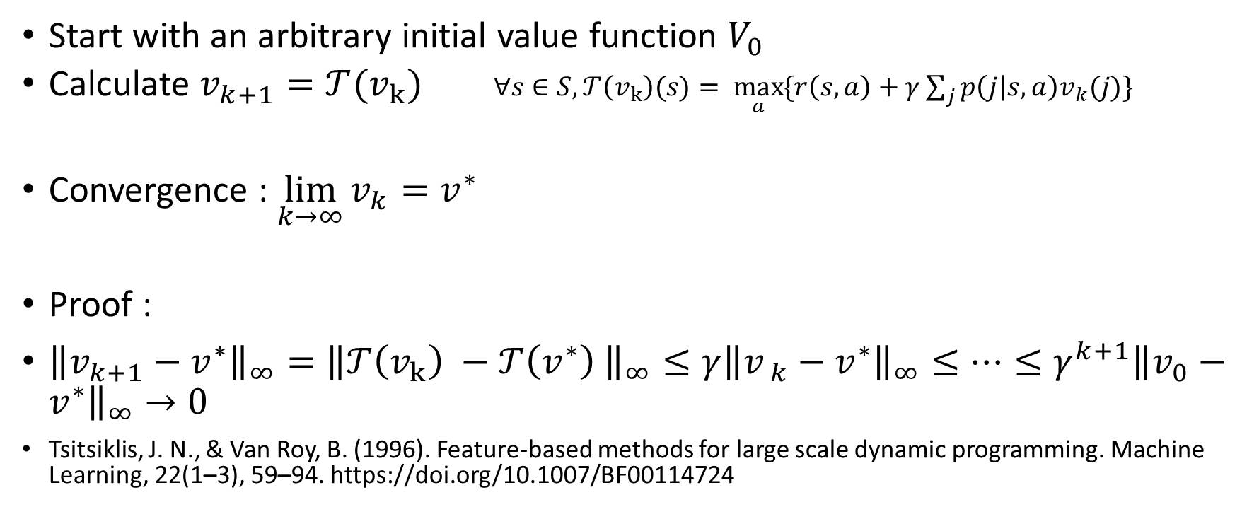
Value iteration with look-up table
Start with an arbitrary initial value function $V_{0}$
Calculate $v_{k+1}=𝒯(v_{k})$ $∀s∈S,𝒯\left(v_{k}\right)(s)= \max_{a}{\{r\left(s,a\right)+γ\sum_{j}{p\left(j | s,a\right)v_{k}(j)}\}}$
Convergence : $\lim_{k→∞}{v_{k}}=v^{∗}$
Proof :
${\left\|v_{k+1}−v^{∗}\right\|}_{∞}={\left\|𝒯\left(v_{k}\right) −𝒯\left(v^{∗}\right) \right\|}_{∞}≤γ{\left\|v_{ k}−v^{∗}\right\|}_{∞}≤…≤γ^{k+1}{\left\|v_{0}−v^{∗}\right\|}_{∞}→0$
Tsitsiklis, J. N., & Van Roy, B. (1996). Feature-based methods for large scale dynamic programming. Machine Learning, 22(1–3), 59–94. https://doi.org/10.1007/BF00114724

Slide 10
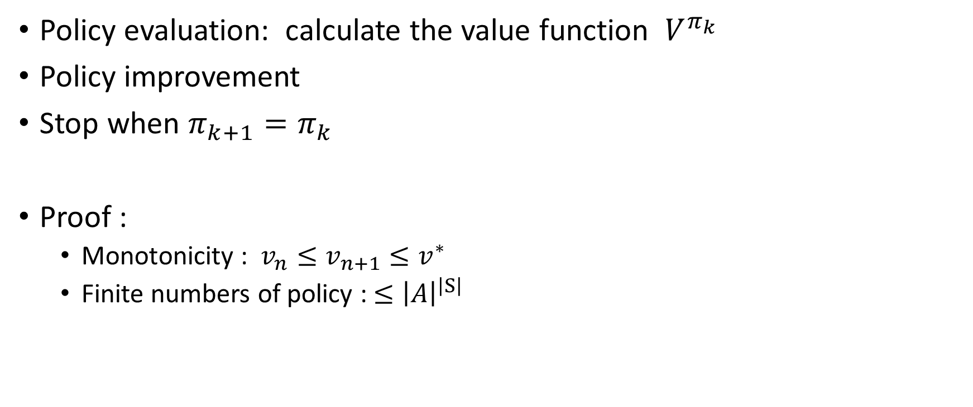
Policy iteration with look-up table
Policy evaluation: calculate the value function $V^{π_{k} }$
Policy improvement
Stop when $π_{k+1}=π_{k}$
Proof :
Monotonicity : $v_{n}≤v_{n+1}≤v^{∗}$
Finite numbers of policy : ${≤\left|A\right|}^{\left|S\right|}$

Slide 11
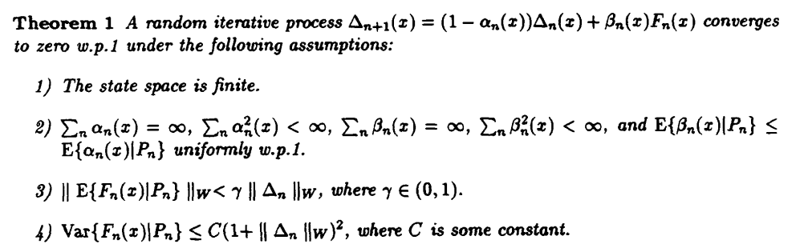
Q-learning with look up table
Borkar, V. S., & Meyn, S. P. (2000). The O.D.E. Method for Convergence of Stochastic Approximation and Reinforcement Learning. SIAM Journal on Control and Optimization, 38(2), 447–469. https://doi.org/10.1137/S0363012997331639
Jaakkola, T., Jordan, M. I., & Singh, S. P. (1994). On the Convergence of Stochastic Iterative Dynamic Programming Algorithms. Neural Computation. https://doi.org/10.1162/neco.1994.6.6.1185

Slide 12
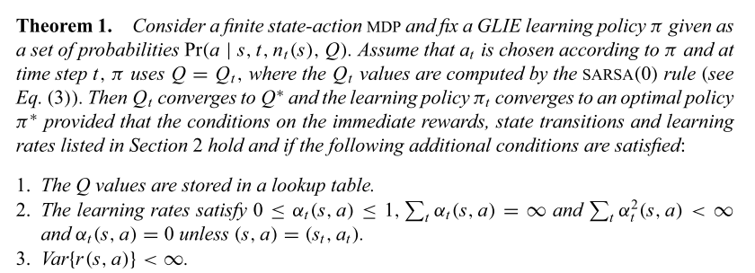
SARSA with look up table
Singh, S., Jaakkola, T., Littman, M. L., & Szepesvári, C. (2000). Convergence results for single-step on-policy reinforcement-learning algorithms. Machine Learning, 38(3), 287–308. https://doi.org/10.1023/A:1007678930559

Slide 13
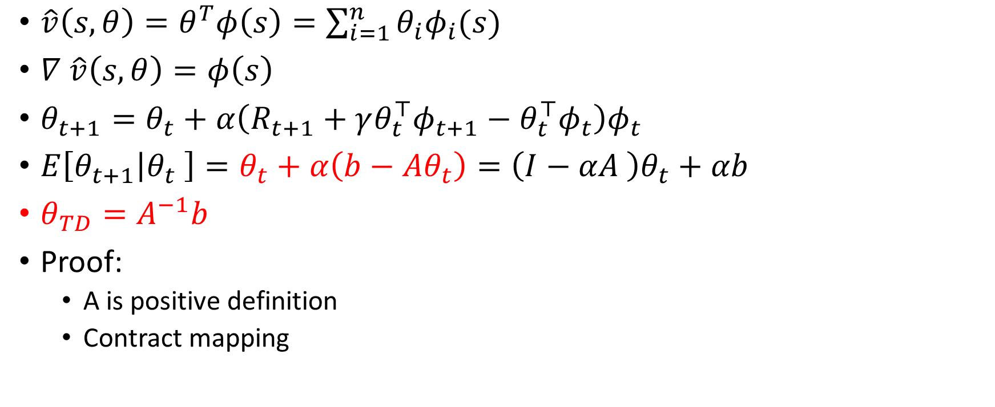
TD(0) with linear approximation(on policy)
$\hat{v}\left(s,θ\right)=θ^{T}φ\left(s\right)=\sum_{i=1}^{n}{θ_{i}φ_{i}(s)}$
$∇ \hat{v}\left(s,θ\right)=φ\left(s\right)$
$θ_{t+1}=θ_{t}+α\left(R_{t+1}+γθ_{t}^{⊤}φ_{t+1}−θ_{t}^{⊤}φ_{t}\right)φ_{t}$
$E\left[θ_{t+1} | θ_{t} \right]=θ_{t}+α\left(b−Aθ_{t}\right)=\left(I−αA \right)θ_{t}+αb$
$θ_{TD}=A^{−1}b$
Proof:
A is positive definition
Contract mapping

Slide 14
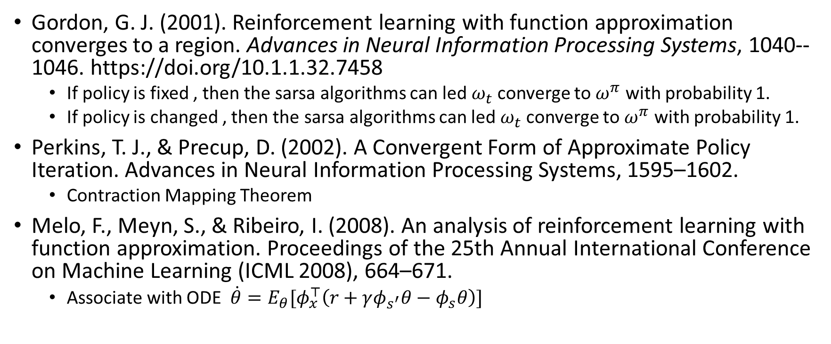
SARSA with linear approximation(on policy)
Gordon, G. J. (2001). Reinforcement learning with function approximation converges to a region. Advances in Neural Information Processing Systems, 1040--1046. https://doi.org/10.1.1.32.7458
If policy is fixed , then the sarsa algorithms can led $ω_{t}$converge to $ω^{π}$ with probability 1.
If policy is changed , then the sarsa algorithms can led $ω_{t}$converge to $ω^{π}$ with probability 1.
Perkins, T. J., & Precup, D. (2002). A Convergent Form of Approximate Policy Iteration. Advances in Neural Information Processing Systems, 1595–1602.
Contraction Mapping Theorem
Melo, F., Meyn, S., & Ribeiro, I. (2008). An analysis of reinforcement learning with function approximation. Proceedings of the 25th Annual International Conference on Machine Learning (ICML 2008), 664–671.
Associate with ODE $\dot{θ}=E_{θ}[φ_{x}^{⊤}\left(r+γφ_{s^{′}}θ−φ_{s}θ\right)]$

Slide 15
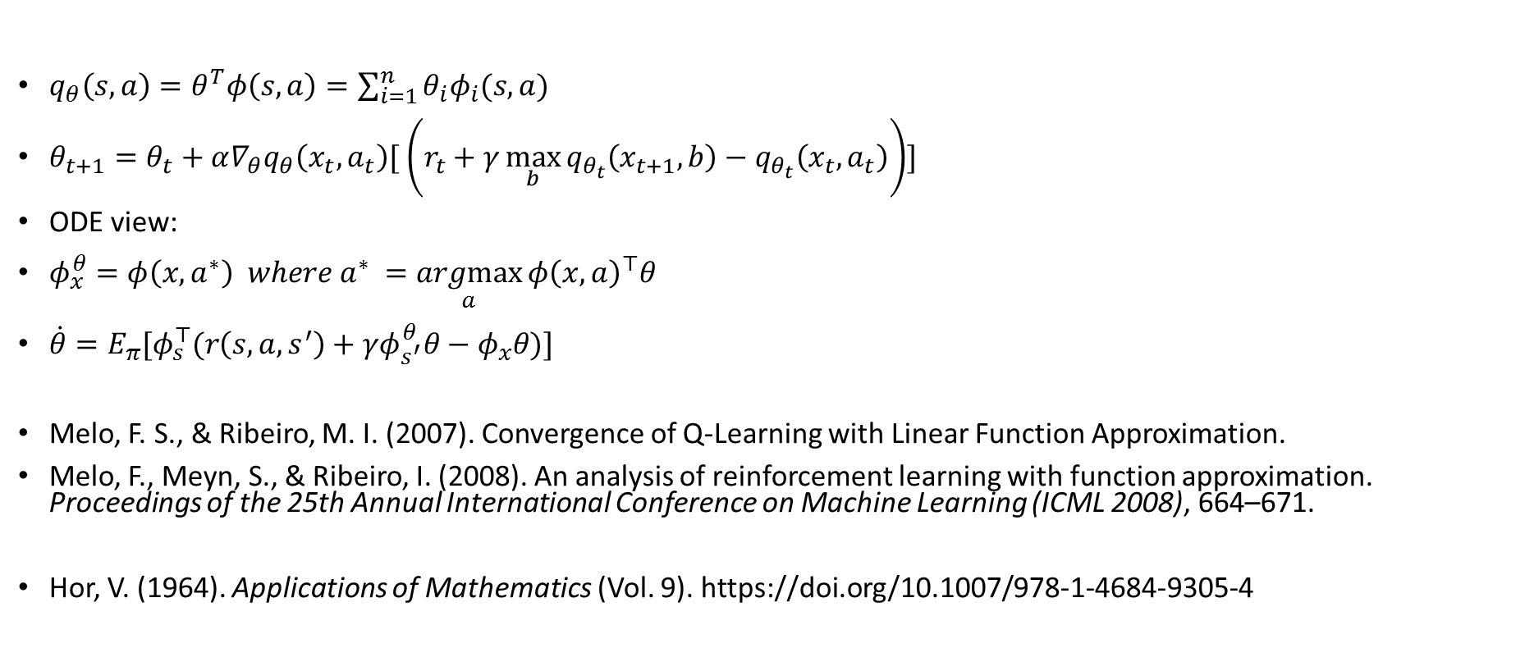
Q learning with linear approximation(off policy)
$q_{θ}\left(s,a\right)=θ^{T}φ\left(s,a\right)=\sum_{i=1}^{n}{θ_{i}φ_{i}(s,a)}$
$θ_{t+1}=θ_{t}+α∇_{θ}q_{θ}\left(x_{t},a_{t}\right)[ \left(r_{t}+γ\max_{b}{q_{θ_{t}}\left(x_{t+1},b\right)}−q_{θ_{t}}\left(x_{t},a_{t}\right)\right)]$
ODE view:
$φ_{x}^{θ}=φ\left(x,a^{∗}\right) where a^{∗} =\underset{a}{argmax}{φ{\left(x,a\right)}^{⊤}θ }$
$\dot{θ}=E_{π}[φ_{s}^{⊤}(r\left(s,a,s^{′}\right)+γφ_{s^{′}}^{θ}θ−φ_{x}θ)]$
Melo, F. S., & Ribeiro, M. I. (2007). Convergence of Q-Learning with Linear Function Approximation.
Melo, F., Meyn, S., & Ribeiro, I. (2008). An analysis of reinforcement learning with function approximation. Proceedings of the 25th Annual International Conference on Machine Learning (ICML 2008), 664–671.
Hor, V. (1964). Applications of Mathematics (Vol. 9). https://doi.org/10.1007/978-1-4684-9305-4

Slide 16
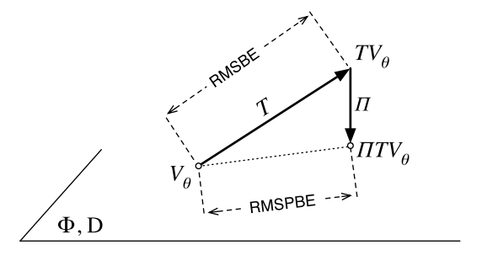
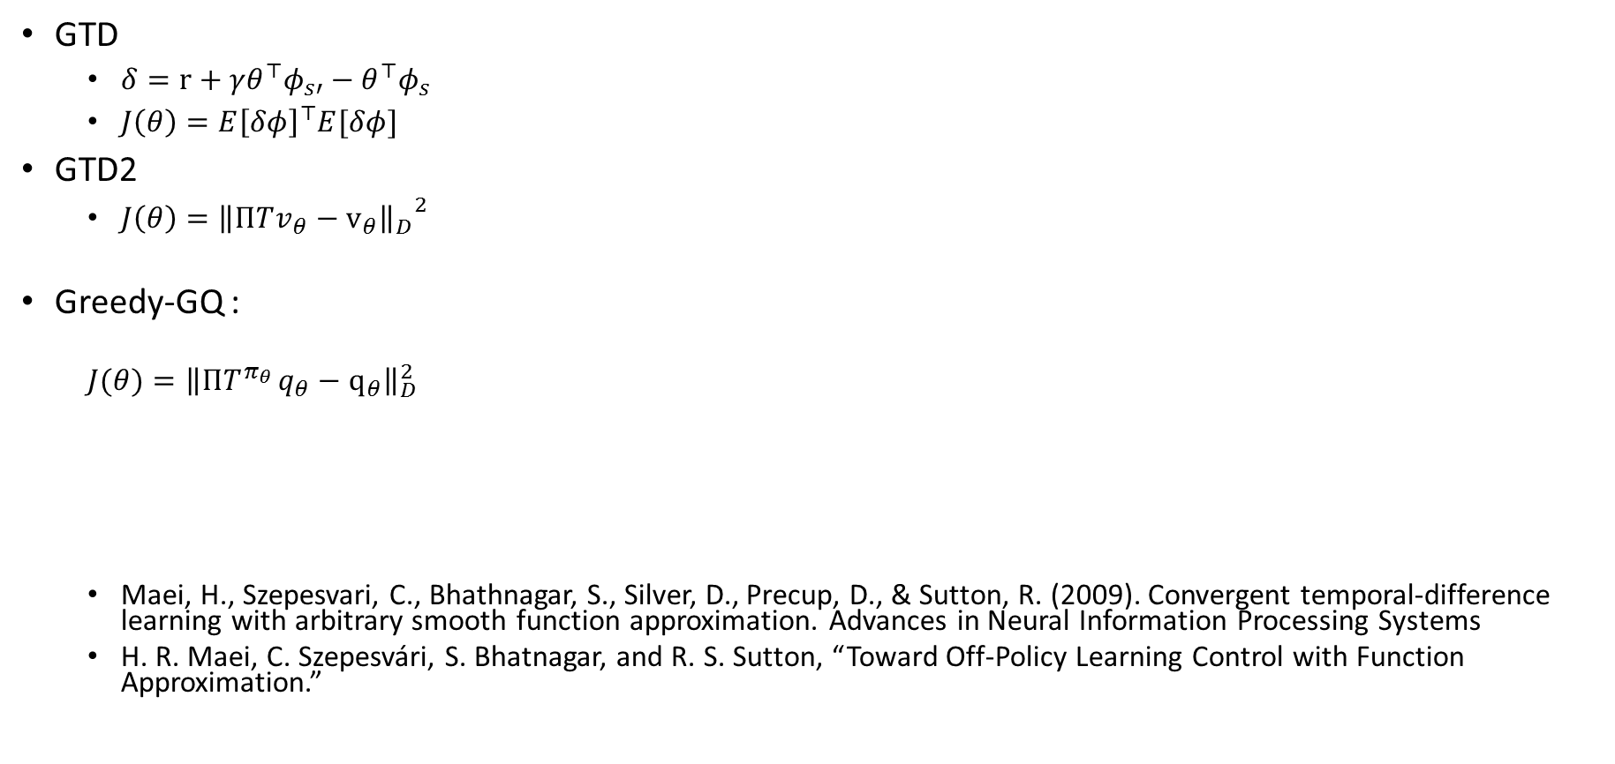
Some new algorithms
GTD
$δ=r+γθ^{⊤}φ_{s′}−θ^{⊤}φ_{s}$
$J\left(θ\right)=E{\left[δφ\right]}^{⊤}E[δφ]$
GTD2
$J\left(θ\right)={{\left\|ΠTv_{θ}−v_{θ}\right\|}_{D}}^{2}$
Greedy-GQ :
$$J(θ)={\left\|ΠT^{π_{θ} }q_{θ}−q_{θ}\right\|}_{D}^{2}$$
Maei, H., Szepesvari, C., Bhathnagar, S., Silver, D., Precup, D., & Sutton, R. (2009). Convergent temporal-difference learning with arbitrary smooth function approximation. Advances in Neural Information Processing Systems
H. R. Maei, C. Szepesvári, S. Bhatnagar, and R. S. Sutton, “Toward Off-Policy Learning Control with Function Approximation.”

Slide 17

Some new algorithms
$\text{Greedy}\text{-}\text{GQ}\text{ :}$
$$J(θ)={\left\|ΠT^{π_{θ} }q_{θ}−q_{θ}\right\|}_{μ}^{2}$$
$$θ_{t+1}=θ_{t}+α_{t}\left[δ_{t+1}\left(θ_{t}\right)φ_{t}−γ\left(ω_{t}^{⊤}φ_{t}\right){\hat{φ}}_{t+1}\left(θ_{t}\right)\right]$$
$$ω_{t+1}=ω_{t}+β_{t}\left[δ_{t+1}\left(θ_{t}\right)−φ_{t}^{⊤}ω_{t}\right]φ_{t}$$

Slide 18
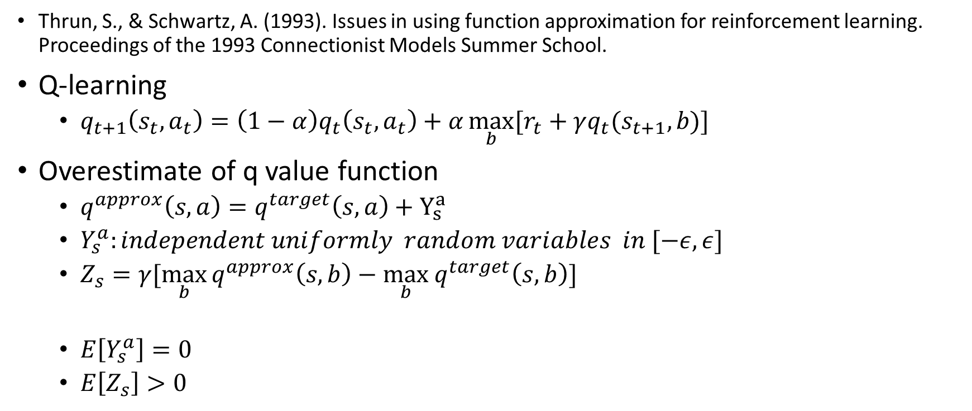
counterexample
Thrun, S., & Schwartz, A. (1993). Issues in using function approximation for reinforcement learning. Proceedings of the 1993 Connectionist Models Summer School.
Q-learning
$q_{t+1}\left(s_{t},a_{t}\right)=\left(1−α\right)q_{t}\left(s_{t},a_{t}\right)+α\max_{b}{[r_{t}+γq_{t}(s_{t+1},b)]}$
Overestimate of q value function
$q^{approx}\left(s,a\right)=q^{target}\left(s,a\right)+Y_{s}^{a}$
$Y_{s}^{a}:independent uniformly random variables in [−ε,ε]$
$Z_{s}=γ[\max_{b}{q^{approx}\left(s,b\right)−\max_{b} q^{target}\left(s,b\right)}]$
$E\left[Y_{s}^{a}\right]=0$
$E\left[Z_{s}\right]>0$

Slide 19
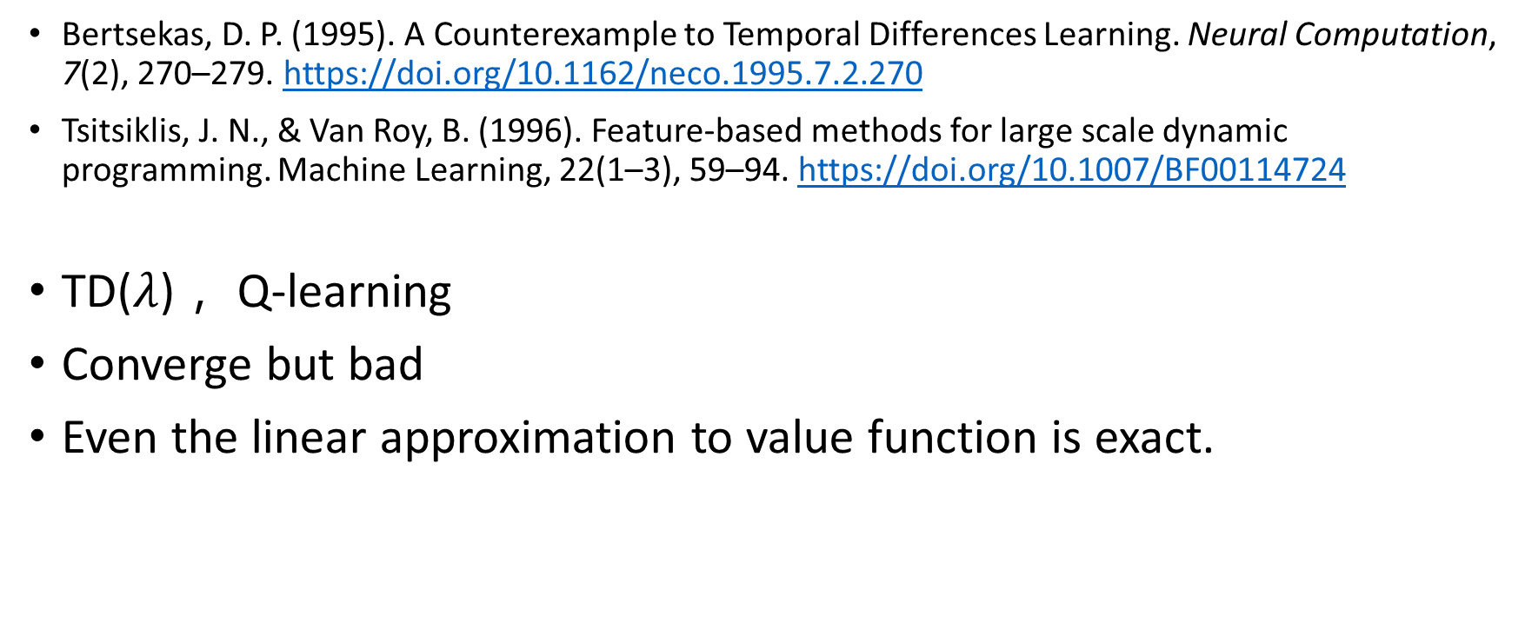
counterexample
Bertsekas, D. P. (1995). A Counterexample to Temporal Differences Learning. Neural Computation, 7(2), 270–279. https://doi.org/10.1162/neco.1995.7.2.270
Tsitsiklis, J. N., & Van Roy, B. (1996). Feature-based methods for large scale dynamic programming. Machine Learning, 22(1–3), 59–94. https://doi.org/10.1007/BF00114724
TD($λ$)， Q-learning
Converge but bad
Even the linear approximation to value function is exact.

Slide 20
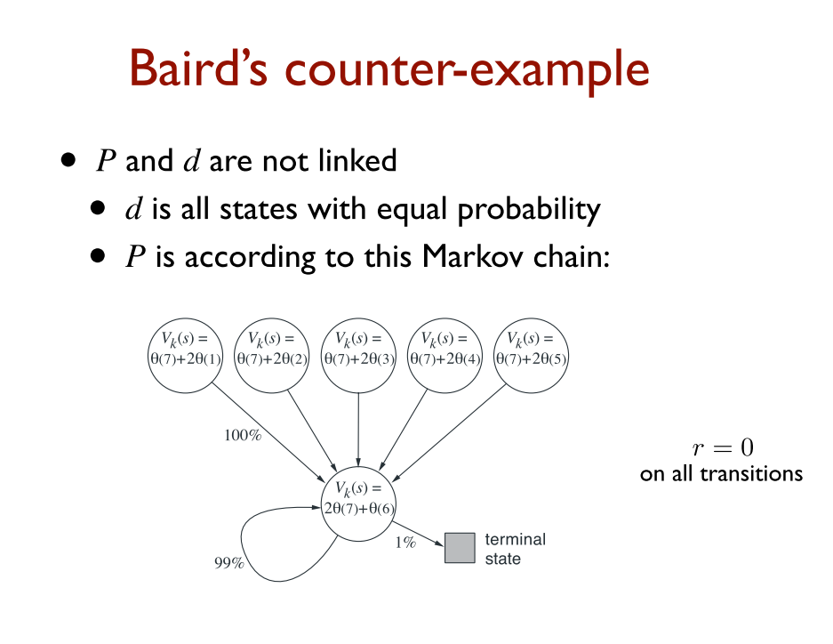
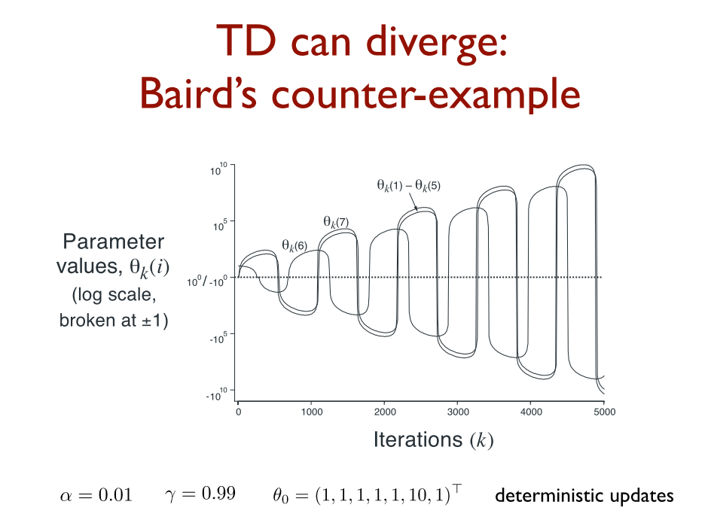
Counter example
L. Baird, “Residual Algorithms: Reinforcement Learning with Function Approximation.,” Icml, pp. 30–37, 1995.

Slide 21
Algorithms with nonlinear function approximation and off policy control
[1] F. Melo, S. Meyn, and I. Ribeiro, “An analysis of reinforcement learning with function approximation,” Proc. 25th Annu. Int. Conf. Mach. Learn. (ICML 2008), pp. 664–671, 2008.
[2] H. R. Maei, C. Szepesvári, S. Bhatnagar, and R. S. Sutton, “Toward Off-Policy Learning Control with Function Approximation.”
[3] H. Maei, C. Szepesvari, S. Bhathnagar, D. Silver, D. Precup, and R. Sutton, “Convergent temporal-difference learning with arbitrary smooth function approximation,” Adv. Neural Inf. Process. Syst., pp. 1–9, 2009.
[4] R. S. Sutton et al., “Fast Gradient-descent Methods for Temporal-difference Learning with Linear Function Approximation,” Proc. 26th Annu. Int. Conf. Mach. Learn., vol. 1, no. 7, pp. 993–1000, 2009.

Slide 22
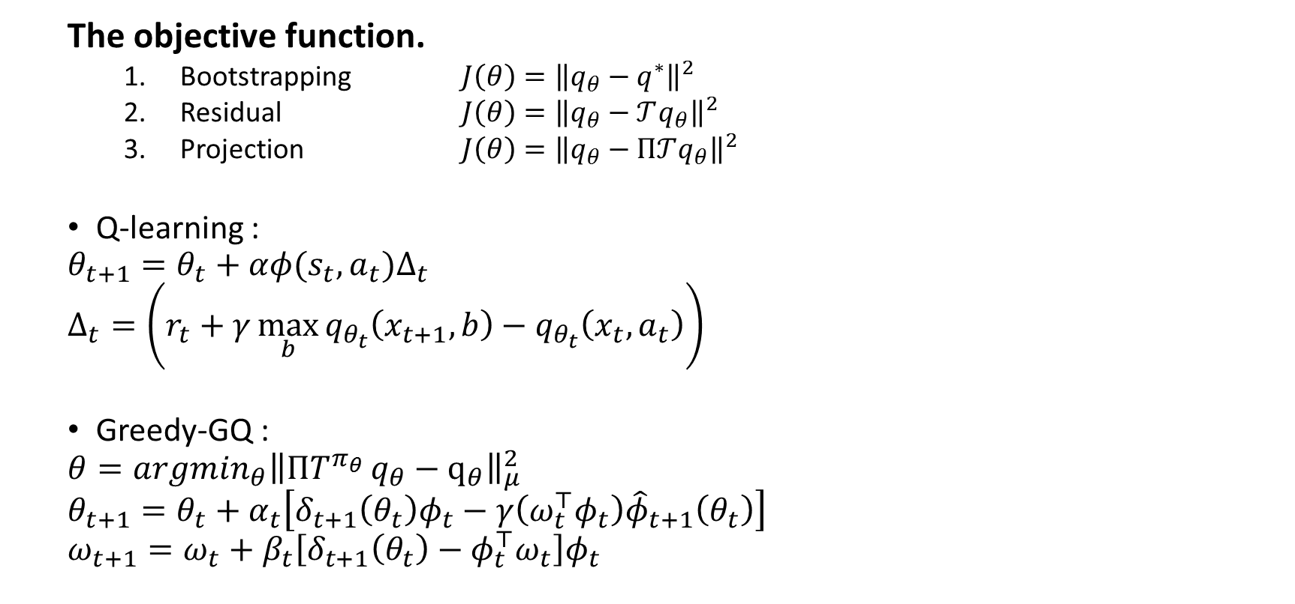
Algorithms with nonlinear function approximation and off policy control
The objective function.
Bootstrapping $J\left(θ\right)={\left\|q_{θ}−q^{∗}\right\|}^{2}$
Residual $J\left(θ\right)={\left\|q_{θ}−𝒯q_{θ}\right\|}^{2}$
Projection $J\left(θ\right)={\left\|q_{θ}−Π𝒯q_{θ}\right\|}^{2}$
Q-learning :
$$θ_{t+1}=θ_{t}+αφ(s_{t},a_{t})Δ_{t}$$
$$Δ_{t}=\left(r_{t}+γ\max_{b}{q_{θ_{t}}\left(x_{t+1},b\right)}−q_{θ_{t}}\left(x_{t},a_{t}\right)\right)$$
Greedy-GQ :
$$θ=argmin_{θ}{\left\|ΠT^{π_{θ} }q_{θ}−q_{θ}\right\|}_{μ}^{2}$$
$$θ_{t+1}=θ_{t}+α_{t}\left[δ_{t+1}\left(θ_{t}\right)φ_{t}−γ\left(ω_{t}^{⊤}φ_{t}\right){\hat{φ}}_{t+1}\left(θ_{t}\right)\right]$$
$$ω_{t+1}=ω_{t}+β_{t}\left[δ_{t+1}\left(θ_{t}\right)−φ_{t}^{⊤}ω_{t}\right]φ_{t}$$

Slide 23

Algorithms with nonlinear function approximation and off policy control
Q-learning :
$$θ_{t+1}=θ_{t}+α∇_{θ}q_{θ}(s_{t},a_{t})Δ_{t}$$
$$Δ_{t}=\left(r_{t}+γ\max_{b}{q_{θ_{t}}\left(x_{t+1},b\right)}−q_{θ_{t}}\left(x_{t},a_{t}\right)\right)$$
max operator is non differentiable
fix point of nonlinear ODE
Greedy-GQ :
$$θ=argmin_{θ}{\left\|ΠT^{π_{θ} }q_{θ}−q_{θ}\right\|}_{μ}^{2}$$
project to a nonlinear surface
max operator is non differentiable

Slide 25

Upper bound of approximate optimal value functions
$\left|v^{∗}\left(x\right)−\hat{v}\left(x\right)\right|≤ε$
$v^{∗}\left(x\right)−v_{\hat{v}}\left(x\right)≤\frac{2γε}{1−γ}$

Slide 26
Is the algorithm convergence ?
The algorithms convergence to where?
How fast the algorithms converge?

Slide 27
 |  | 1 | 2 | 3
Convergence results for single-step on-policy reinforcement-learning algorithms | SARSA(0) | GLIE RRR | control | Look up table
The O.D.E. Method for Convergence of Stochastic Approximation and Reinforcement Learning | Q learning | greedy | control | Look up table
An analysis of reinforcement learning with function approximation | SARSA |  |  | linear
 | Q learning | fix
A Convergent Form of Approximate Policy Iteration | Policy iteration | fix and improve | control | linear | Bootstrapping

